Slide 1
Crossover operators for hardware GP using FPGAs and Handel-C
Peter Martin
University of Essex, UK

Slide 2
Introduction
GP in hardware - why?
Field Programmable Gate Arrays (FPGAs) and Handel-C
Crossover operator
Alternative operators
Conclusions

Slide 3
GP in hardware
Speed up the operation of GP
  Solve hard problems
  Real time data processing for fitness
  Experimental investigation
Embedded GP systems

Slide 4
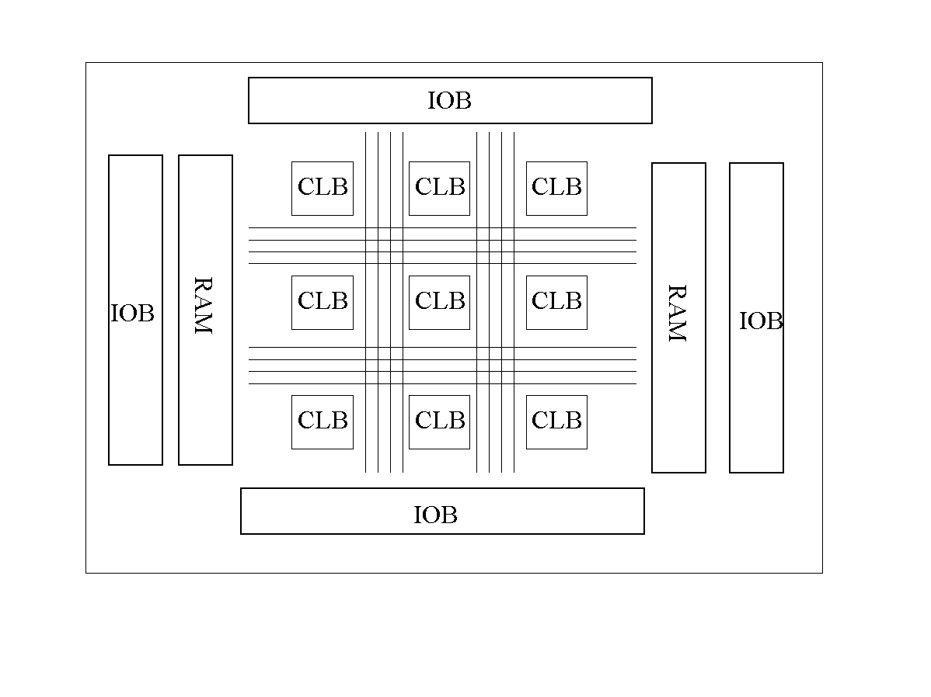
FPGAs
Re-configurable arrays of logic cells
Programmable logic functions
Flexible routing
On-chip memory

Slide 5
Handel-C
High level language to FPGA system
C-like syntax
Extensions for parallelism
    unsigned int 5 a,b;
    par {
    a = 10;
    b = 20;
    }
Predictable timing semantics

Slide 6
Design
Linear representation
  No stack so recursion hard
Population in external RAM
Pipelined execution
  Combinatorial logic is slow
  Trade cycles for speed
  2 levels of pipeline
Parallel fitness evaluations
  Replicated hardware

Slide 7
Crossover operator
Fixed maximum length
Truncating crossover

